Slide 1
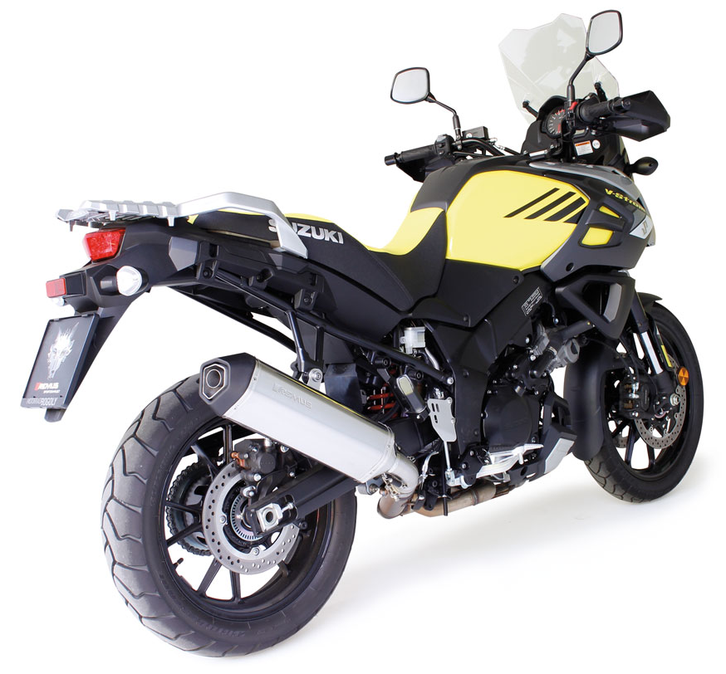
BIKE INFO 22-RACE/2017
+ 2,8 PS
+ 3,3 Nm
- 2,4 kg
Suzuki V-Strom 1000 Mod. 2017 Mod. 2017 RACING EXHAUST OPTIONS FOR EXPORT ONLY

Slide 2
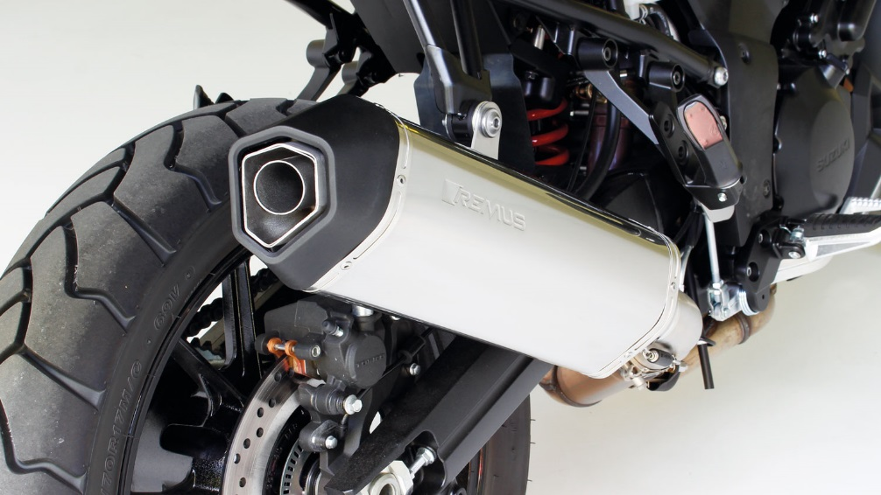
Slip-on RACING OKAMI
Motorrad / Bike
Weight (kg)
 |  |  | stock | REMUS
sleeve |  |  |  | titanium | Carbon
connecting tube |  |  | 5,40 | 0,40
silencer |  |  |  | 2,70 | 2,60
Abbildung kann vom Original abweichen / Picture can deviate from original product

Slide 3
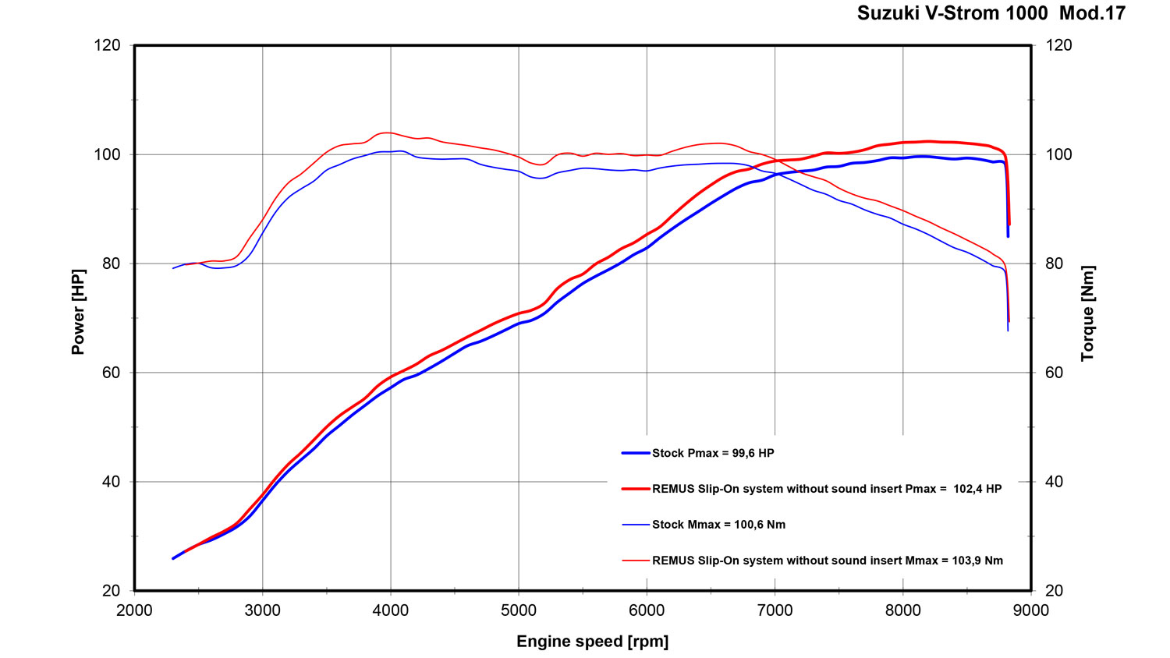
Dyno chart
Technische Änderungen und Irrtümer bleiben vorbehalten. / Subject to technical alterations and errors.

Slide 4
Part numbers
PART NUMBERS IN DETAIL
Modell - type | Bj. year | Ømm | description | Typ type | sleeve version | Artikelnummer part number | EUR exkl. MwSt. EUR excl. VAT
V-Strom 1000 V-Strom 1000XT | 17- | 54 | stainless steel connecting tube |  |  | 0105 857517 | 93,00
 |  |  | OKAMI with removable sound insert | RACE | carbon | 14483 857517 | 386,00
74 kW, WDD0 |  |  | OKAMI with removable sound insert | RACE | titanium | 14883 857517 | 348,00
Preise 2017 in Euro exkl. MwSt. / Prices 2017 in Euro excl. VAT! |  |  |  | Irrtum und Änderung vorbehalten / Errors and omission excepted
SET PART NUMBERS
Modell - type | Bj. year | Ømm | description | Typ type | Schalldämpfer muffler | sleeve version | Setartikelnummer setpartnumber | EUR exkl. MwSt. EUR excl. VAT
V-Strom 1000 V-Strom 1000XT | 17- | 54 | RACING slip on system with removable sound insert | RACE | OKAMI | carbon | 0514483 857517 | 479,00
74 kW, WDD0 |  |  |  | RACE | OKAMI | titanium | 0514883 857517 | 441,00
Preise 2017 in Euro exkl. MwSt. / Prices 2017 in Euro excl. VAT! |  |  |  | Irrtum und Änderung vorbehalten / Errors and omission excepted

