Slide 1
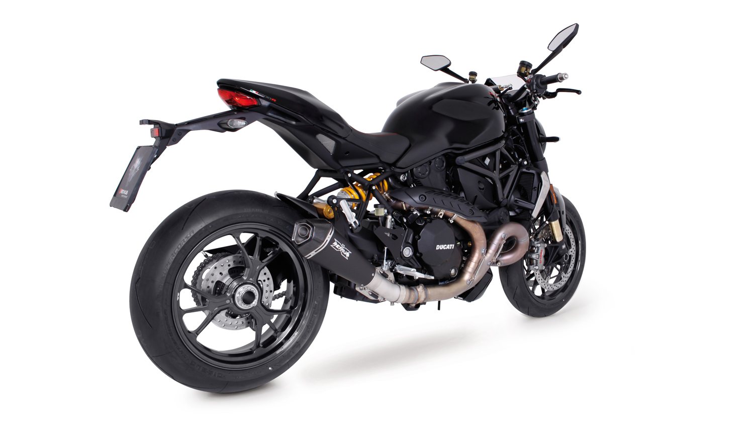
BIKE INFO 18-RACE/2017
+ 5,4 PS
+ 4,0 Nm
- 3,2 kg
Ducati Monster 1200 / S / R Mod. 2017 RACING EXHAUST OPTIONS FOR EXPORT ONLY

Slide 2
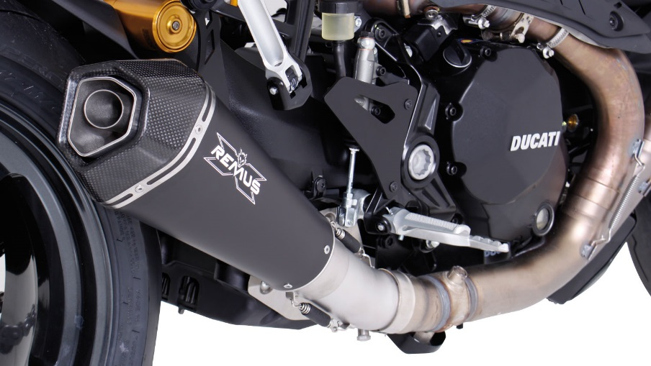
RACING black HYPERCONE
Weight (kg)
 |  |  | stock | REMUS
sleeve |  |  |  | stainless steel | titanium
connecting tube no cat. |  |  | 5,50 | 0,80
silencer |  |  |  | 2,00 | 1,90
Abbildung kann vom Original abweichen / Picture can deviate from original product

Slide 3
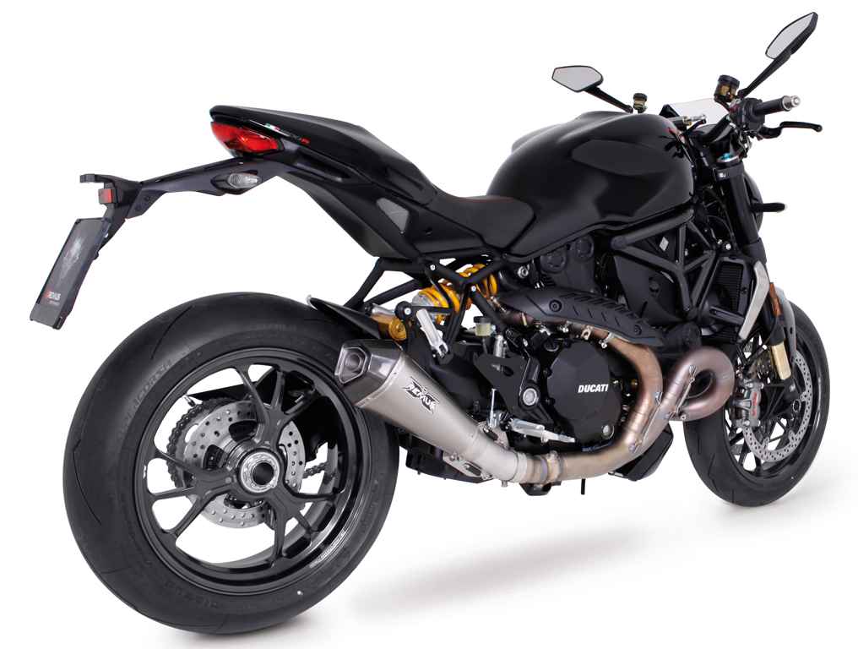
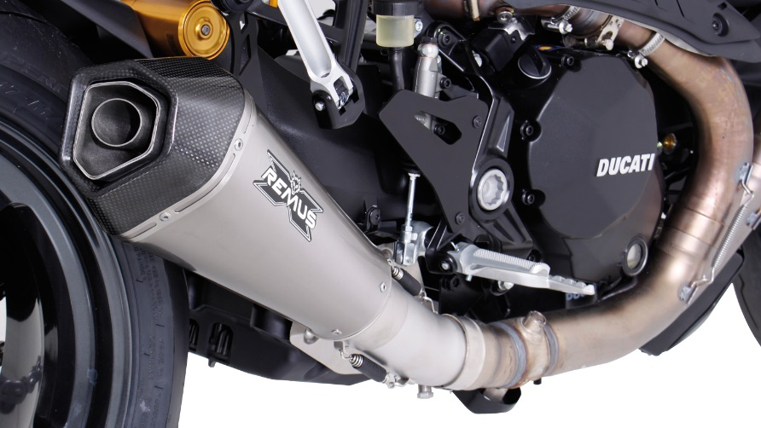
RACING Titanium HYPERCONE
Weight (kg)
 |  |  | stock | REMUS
sleeve |  |  |  | stainless steel | titanium
connecting tube no cat. |  |  | 5,50 | 0,40
silencer |  |  |  | 2,00 | 1,90

Slide 4
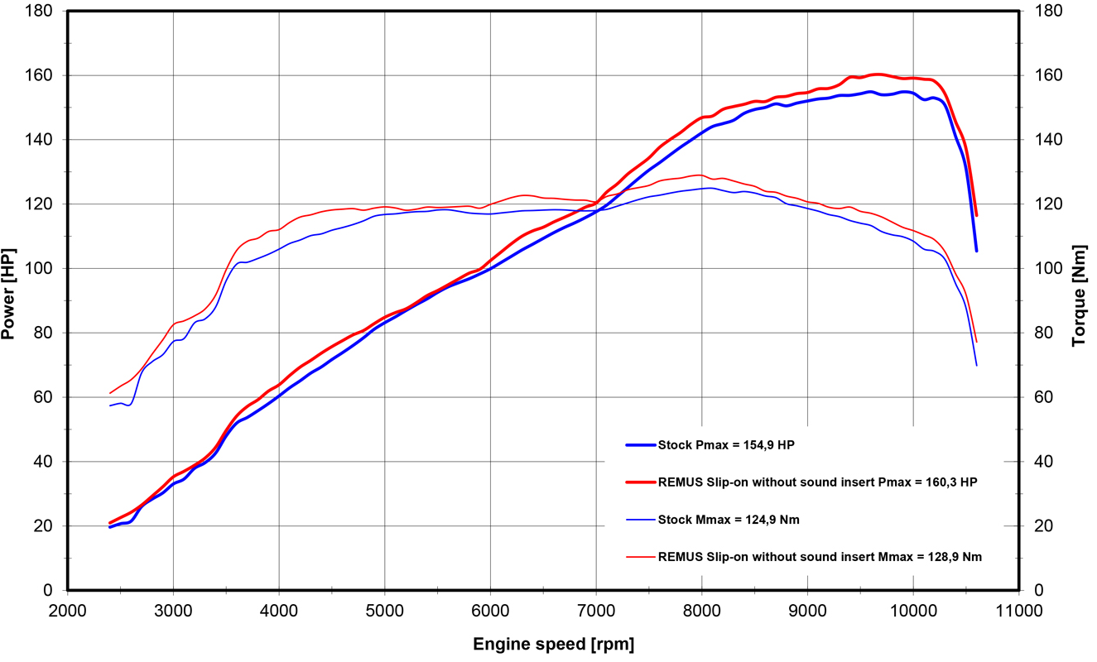
Dyno chart
Technische Änderungen und Irrtümer bleiben vorbehalten. Subject to technical alterations and errors.

Slide 5
Part numbers
PART NUMBERS IN DETAIL
Modell - type | Bj. year | Ømm | description | Typ type | sleeve version | Artikelnummer part number | EUR exkl. MwSt. EUR excl. VAT
Monster 1200 110 kW | 17- | 65
Monster 1200 S 110 kW | 17- |  | stainless steel connecting tube no cat. | RACE |  | 0105 158017 | 101,00
Monster 1200 R 117,7 kW | 16- |  | HYPERCONE with removable sound insert | RACE | stainless steel black | 6783 106365 | 387,00
 |  |  | HYPERCONE with removable sound insert | RACE | titanium | 6883 106365 | 457,00
Preise 2017 in Euro exkl. MwSt. / Prices 2017 in Euro excl. VAT! |  |  |  |  | Irrtum und Änderung vorbehalten / Errors and omission excepted
SET PART NUMBERS
Modell - type | Bj. year | Ømm | description | Typ type | Schalldämpfer muffler | sleeve version | Setartikelnummer Setpartnumber | EUR exkl. MwSt. EUR excl. VAT
Monster 1200 110 kW | 17- | 65 | RACING slip on sport exhaust system with removable sound insert | RACE | HYPERCONE | stainless steel black | 056783 158017 | 488,00
Monster 1200 S 110 kW | 17- |  |  |  | HYPERCONE | titanium | 056883 158017 | 558,00
Monster 1200 R 117,7 kW | 16-
Preise 2017 in Euro exkl. MwSt. / Prices 2017 in Euro excl. VAT! |  |  |  |  |  | Irrtum und Änderung vorbehalten / Errors and omission excepted

