Slide 1
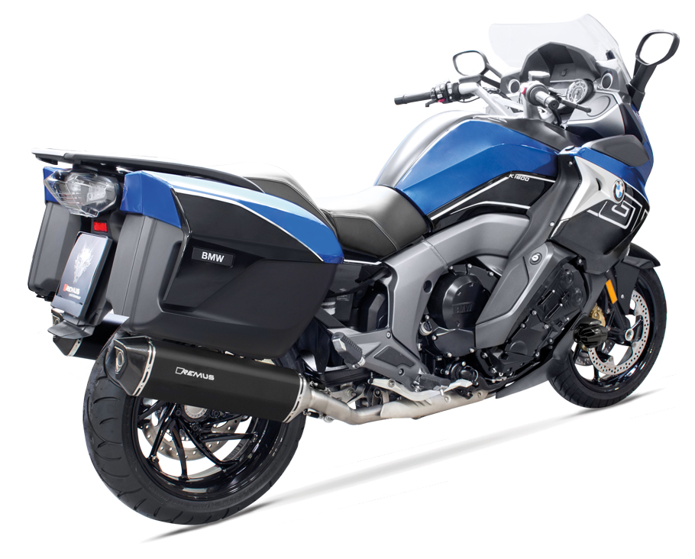
BIKE INFO 10-RACE/2017
+ 2,1 PS
+ 3,0 Nm
- 5,2 kg
BMW K 1600 GT Mod. 2017 RACING EXHAUST OPTIONS FOR EXPORT MARKETS

Slide 2
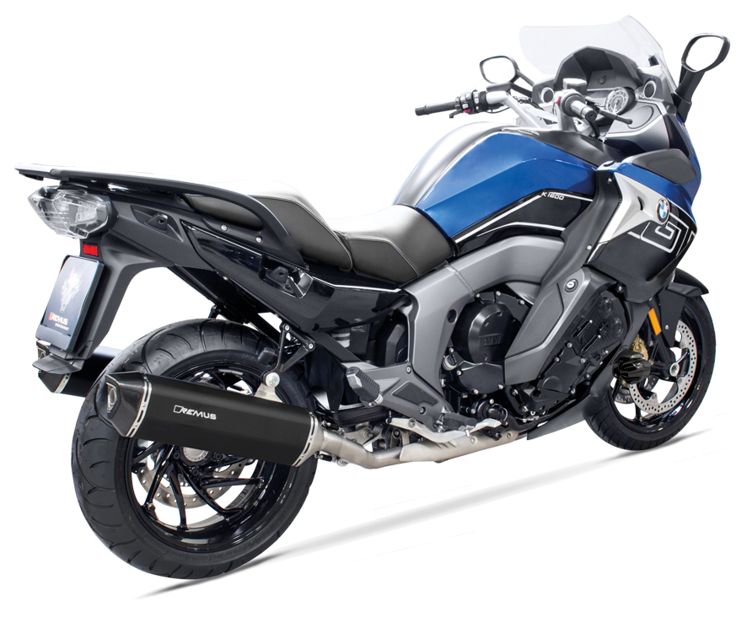
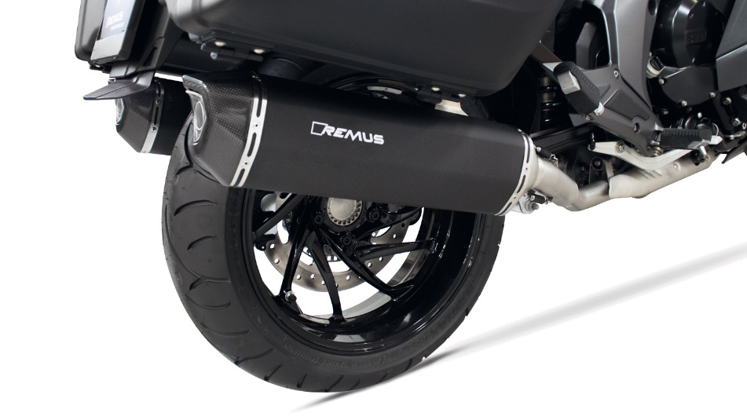
Slip-on BLACK HAWK
Motorrad / Bike
Gewicht / weight (kg)
sleeve | stock | REMUS stainless steel
connecting tube | 11,80 | 1,60
silencer |  | 4,80
Abbildung kann vom Original abweichen / Picture can deviate from original product

Slide 3
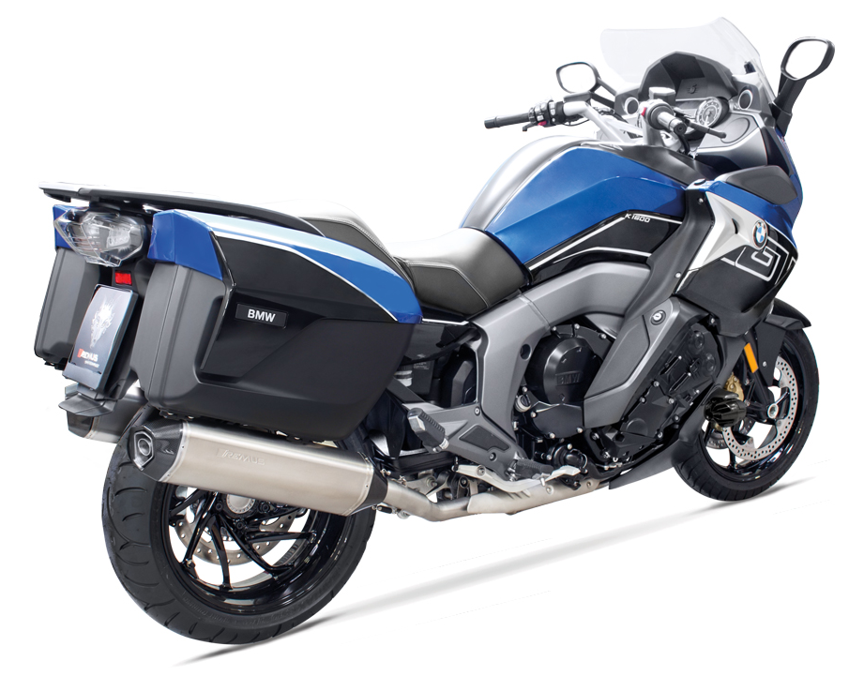
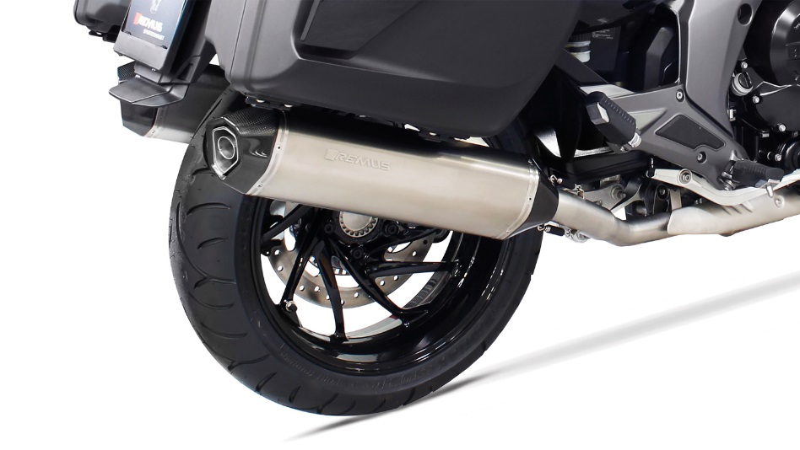
Slip-on HEXACONE
Motorrad / Bike
Gewicht / weight (kg)
sleeve | stock | REMUS
 |  | titanium
connecting tube | 11,80 | 1,60
silencer |  | 5,00
Abbildung kann vom Original abweichen / Picture can deviate from original product

Slide 4
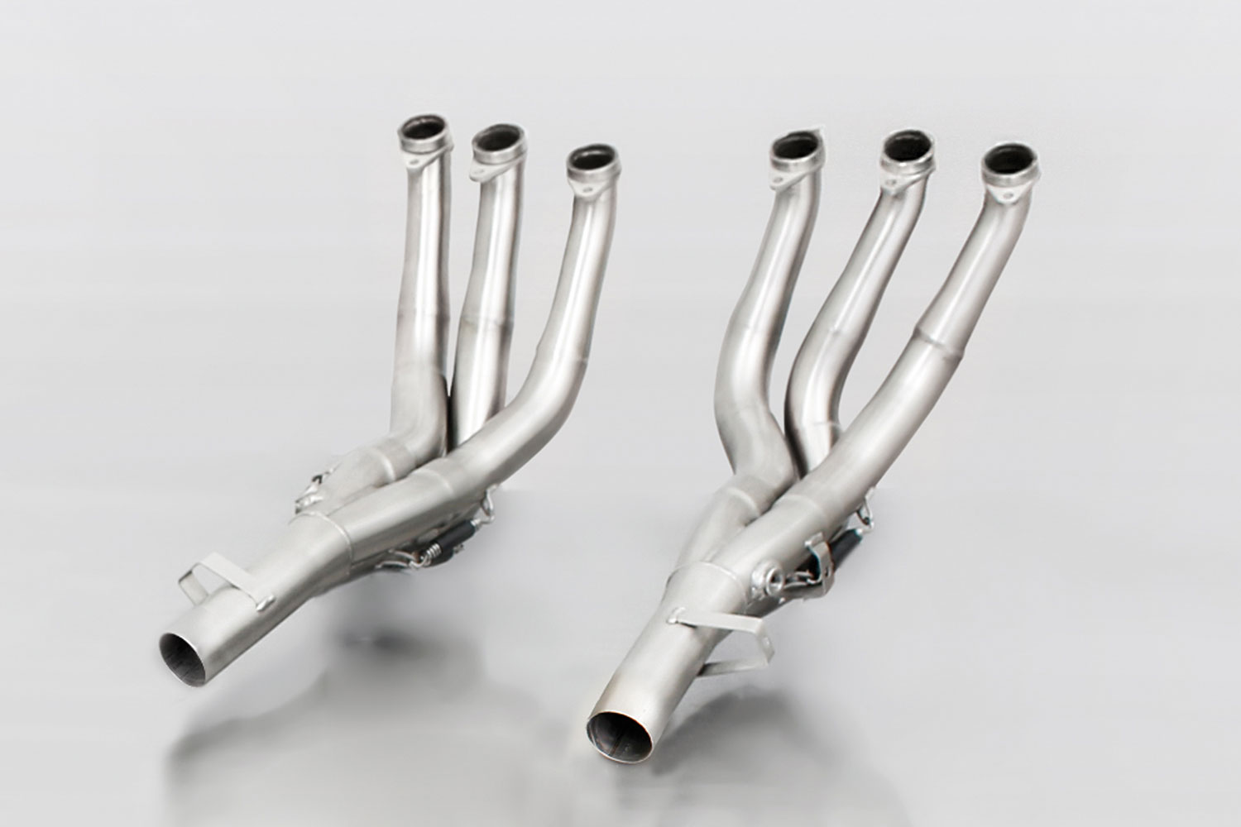
RACING de-cat header
Abbildung kann vom Original abweichen / Picture can deviate from original product

Slide 5
Part numbers
PART NUMBERS IN DETAIL
Modell - type | Bj. year | Ømm | description | Typ type | sleeve version | Artikelnummer part number | EUR exkl. MwSt. EUR excl. VAT
K 1600 GT | 17- | 54 | Stainless steel connecting tube left | RACE | Stainless steel | 0105 089911L | 107,00
K 1600 GTL |  |  | Stainless steel connecting tube right | RACE | Stainless steel | 0105 089911R | 107,00
118 kW, 2T16 |  |  | HEXACONE left, with removable sound insert | RACE | Titanium | 4883 100054L | 492,00
 |  |  | HEXACONE right, with removable sound insert | RACE | Titanium | 4883 100054 | 492,00
 |  |  | BLACK HAWK left, with removable sound insert | RACE | Stainless steel black | 64783 100054L | 447,00
 |  |  | BLACK HAWK right, with removable sound insert | RACE | Stainless steel black | 64783 100054 | 447,00
 |  |  | Stainless steel header (6-2) no cat. instead of original header | RACE | Stainless steel | 0101 089911 | 928,00
Preise 2017 in Euro exkl. MwSt. / Prices 2017 in Euro excl. VAT! |  |  |  | Irrtum und Änderung vorbehalten / Errors and omission excepted
SET PART NUMBERS
Modell - type | Bj. year | Ømm | description | Typ type | Schalldämpfer muffler | sleeve version | Setartikelnummer setpartnumber | EUR exkl. MwSt. EUR excl. VAT
K 1600 GT | 17- | 54 | RACING slip on left/right sport exhaust system with removable sound inserts | RACE | HEXACONE | Titanium | 054883 089917LR | 1.198,00
K 1600 GTL |  |  |  | RACE | BLACK HAWK | Stainless steel black | 0564783 089917LR | 1.108,00
118 kW, 2T16 |  |  | RACING stainless steel header (6-2) no cat. instead of original header | RACE |  | Stainless steel | 0101 089911 | 928,00
Preise 2017 in Euro exkl. MwSt. / Prices 2017 in Euro excl. VAT! |  |  |  |  |  | Irrtum und Änderung vorbehalten / Errors and omission excepted

